Slide 1
Fortune Algo Cookies
Application of Prophet, Algorithmic Trading Strategies and Machine Learning
Prajwal Patnaik, Diana Zhang, Bruno Ivasic, Kerry Zhang
18 December 2023
Notes:
The financial market is a complex and dynamic system, characterized by numerous variables and factors influencing stock prices and market behavior. Our project aims to delve into this intricate world, using machine learning to uncover underlying patterns and trends that could provide insights into market dynamics.

Slide 2


CONTENTS
Executive Summary
Project Goals
Source of Data
Data Preparation and Training
Time series analysis with prophet
Algorithmic Strategies - DMAC, BB, RSI
Optimization Model Implementation
Backtesting, Results and Observations
Conclusion and Future Plans
Fortune Algo Cookies

Slide 3
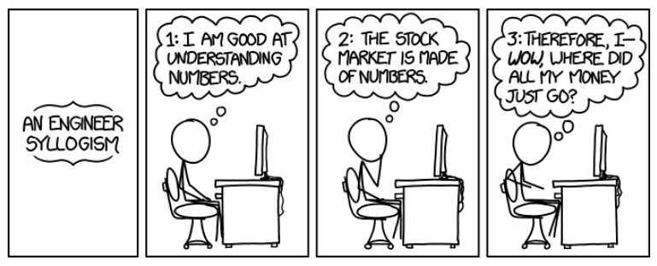
EXECUTIVE SUMMARY
This project leverages multiple skills and methodologies to develop algorithmic trading strategies for stocks incorporating multiple algorithmic strategies and machine learning algorithms. A low-risk stock trading data PepsiCo, Inc. Common Stock (NASDAQ:PEP) is taken for this project. The data spans over the last five (5) years from the 17th of December 2023, and is sourced from Yahoo Finance.
Fortune Algo Cookies

Slide 4
PROJECT GOALS
Machine Learning & Optimisation
Implementing machine learning to automate the trade decisions, for newer data adaptability. Further optimizing each model to determine the best parameters.
Algorithmic Trading
Developing various algorithmic trading strategies to generate buy and sell signals and assessing their performance using back-testing and risk/reward characteristics.
Data Exploration
Sourcing suitable stock market historical data from a credible source for a minimum of 5 years.
Fortune Algo Cookies

Slide 5

DATA SOURCE
Yahoo Finance data (fetched via the yfinance* API) is used
Adequate amount of historical data for the proof of concept.
Ample current statistical and technical data with a single API call .
Free, reliable, and open sourced.
No account or API key needed, therefore simple integration.
Additional Consideration - “Financial Modelling Prep”** API:
Offers many interesting data sets (e.g. EPS Surprises, Executive Compensation, Analyst Estimates to name a few) however most are available only on the paid tier.
Needed sign-up to account and API key.
(*) yfinance is an open-source tool that uses Yahoo's publicly available APIs, and is intended for research and educational purposes. It is a complete re-write of the Yahoo Finance library, offering a reliable method of downloading historical market data from Yahoo! Finance's API, up to 1 minute granularity, in a more Pythonic way.
(**) https://site.financialmodelingprep.com/developer/docs
Fortune Algo Cookies

Slide 6
DATA ANALYTICS
Data Collection
Data Preparation
Exploratory Data Analysis
A low-risk (low beta) stock is used for the analysis. The PepsiCo. (PEP) stock backdated to the last 5 years is imported.
For Trading Algorithms:
Trading signals (buy/sell/ hold) were generated for each algorithm.
Dropping null values and other data wrangling methodologies were introduced wherever applicable.
Generation of other variables and performance metrics.
For Machine Learning:
Train-Test split using DateOffset to create rolling windows*.
Standardisation of data.
For Optimisation
Using ‘backtest’ and ‘strategy’ functions to generate classes to backtest and optimise the parameters.
Plotting the closing price with technical indicators, entry/exit points.
Assessing the risk/reward characteristics using the Annualised & Cumulative Returns, Annualised Volatility, and Sharpe & Sortino Ratios.
Classification Reports for Machine Learning to determine precision and recall.
Fortune Algo Cookies
* Data was split into Train-Test data sets based on 3m+1m rolling windows, to provide a variety of conditions. e.g.: Jan-Mar + May-Jul + Sep-Nov as Train; Apr + Aug + Dec as Test

Slide 7


TIME SERIES ANALYSIS WITH PROPHET
Facebook Prophet is particularly useful for medium-term forecasting where external factors and seasonality play a significant role.
Using ‘Prophet’ the future closing price for the next 90 days is forecasted.
Why Prophet?
Seasonality Handling
Irregular Trends
Ease of Use
External Factors
Uncertainty Levels
Fortune Algo Cookies
Notes:
Seasonality Handling - Efficiently detects and adjusts for various seasonal patterns in stock data.
Irregular Trends - Capable of handling non-linear trends, crucial for volatile stock market movements.
Ease of Use - User-friendly with minimal tuning required, suitable for those with limited time-series expertise.
External Factors - Allows incorporation of events and holidays that can impact stock prices.
Uncertainty Intervals - Provides automatic uncertainty intervals, offering a reliability gauge for predictions

Slide 8
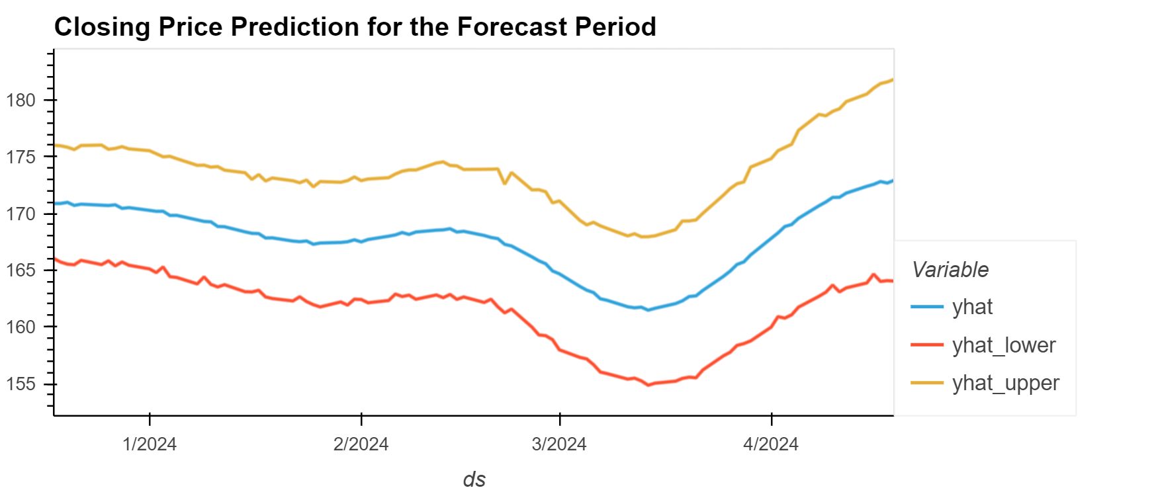
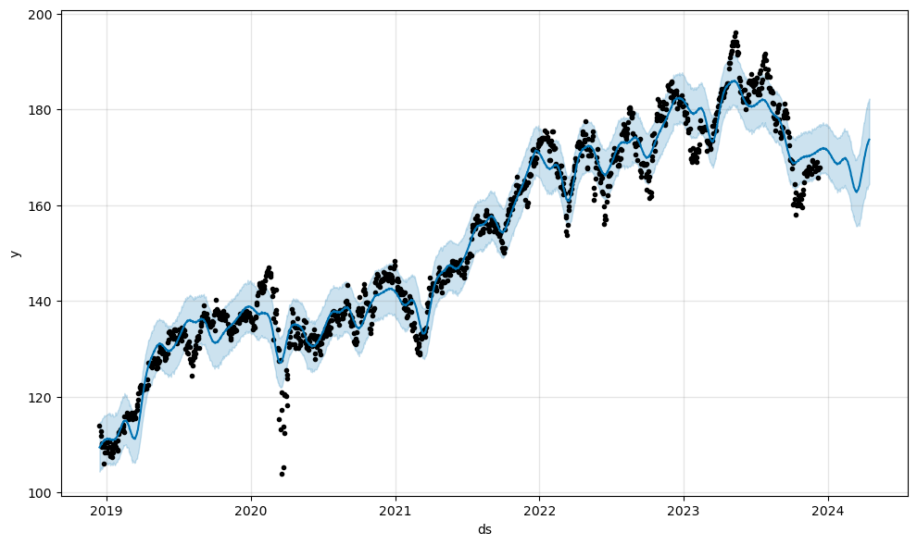
TIME SERIES ANALYSIS WITH PROPHET
Median Closing Price of the three scenarios over the next 90 days
Best Case
$173.81
Worst Case
$162.43
$168.12
Fortune Algo Cookies
Most Likely

Slide 9
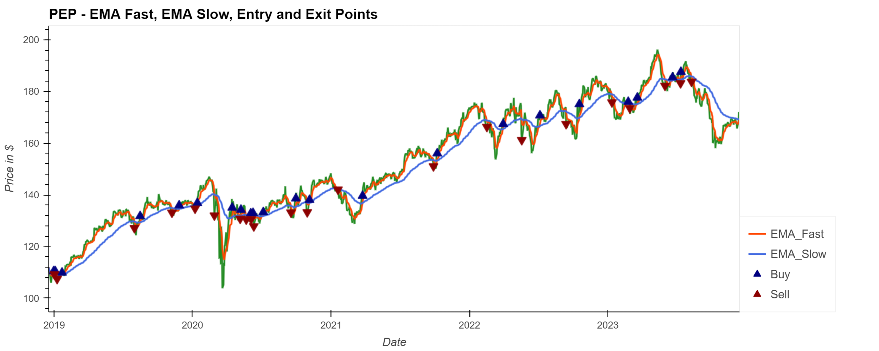
ALGORITHMIC STRATEGIES
Dual-Moving Average Crossover (DMAC)
The DMAC system uses two moving averages (one short term, one long term) to generate trading signals.
The shorter moving average is more responsive to recent price changes, while the longer moving average is more stable.
Determining Trading Signals:
Buy Signal: Short > Long
Sell Signal: Short <= Long
Parameter Set up with Optimisation:
Exponential Moving Average (EMA)
Short Term: 8 days
Long Term: 68 days
Fortune Algo Cookies

Slide 10
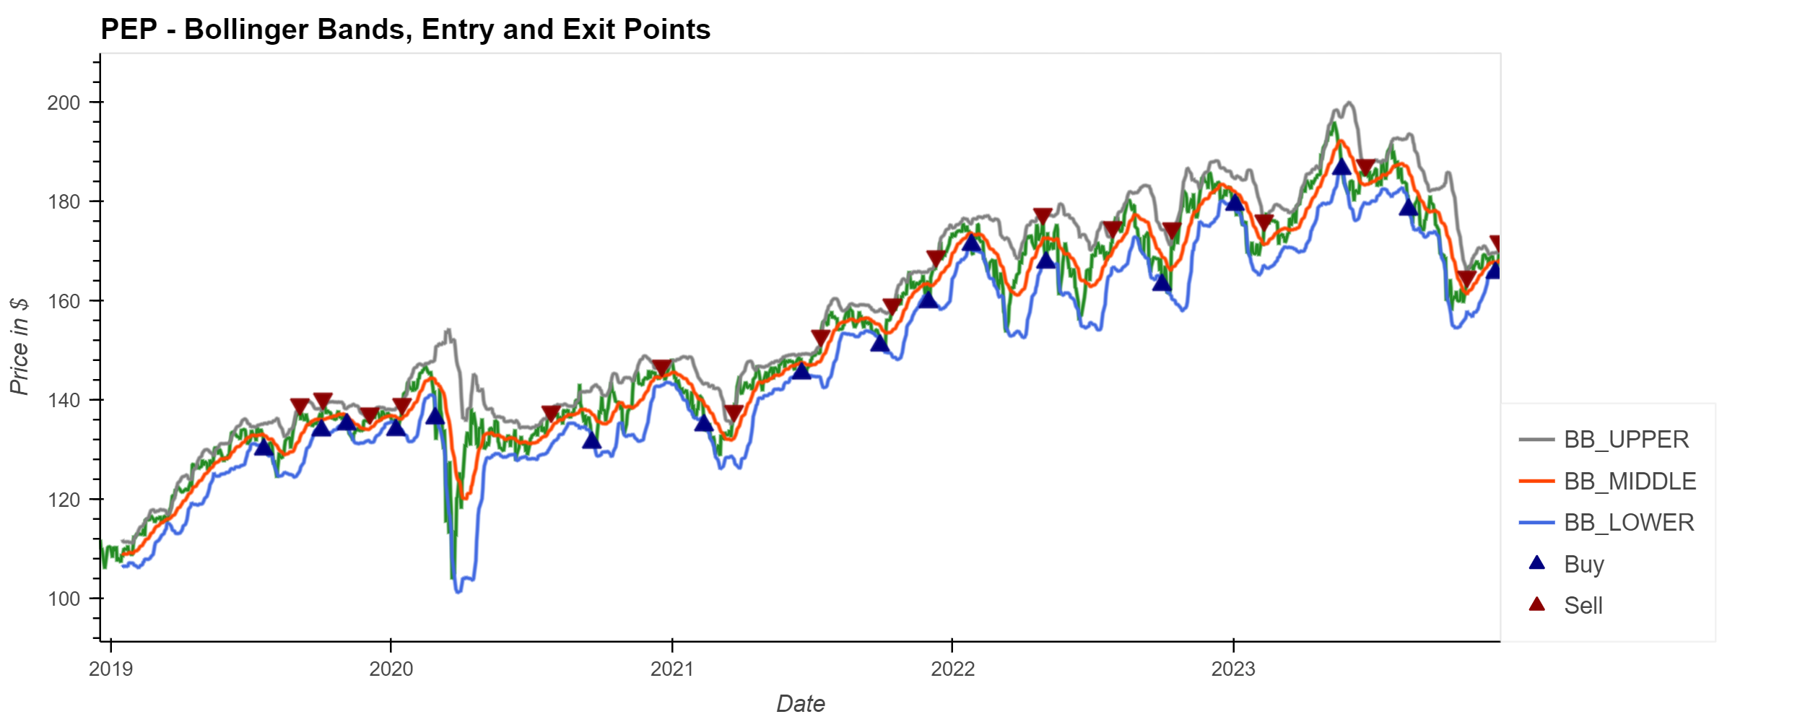
ALGORITHMIC STRATEGIES
Bollinger Bands (BB)
Volatility indicator that consists of three lines:
One simple moving average (SMA) - the centre line.
Two additional lines above and below the SMA that represent the standard deviations (usually two).
Determining Trading Signals:
High Volatility: Wider bands indicate higher market volatility.
Low Volatility: Narrower bands suggest lower volatility.
Overbought: Price > Upper Band
Oversold: Price < Lower Band
Parameter Set up:
Stop Loss Percentage – 30%
Fortune Algo Cookies

Slide 11
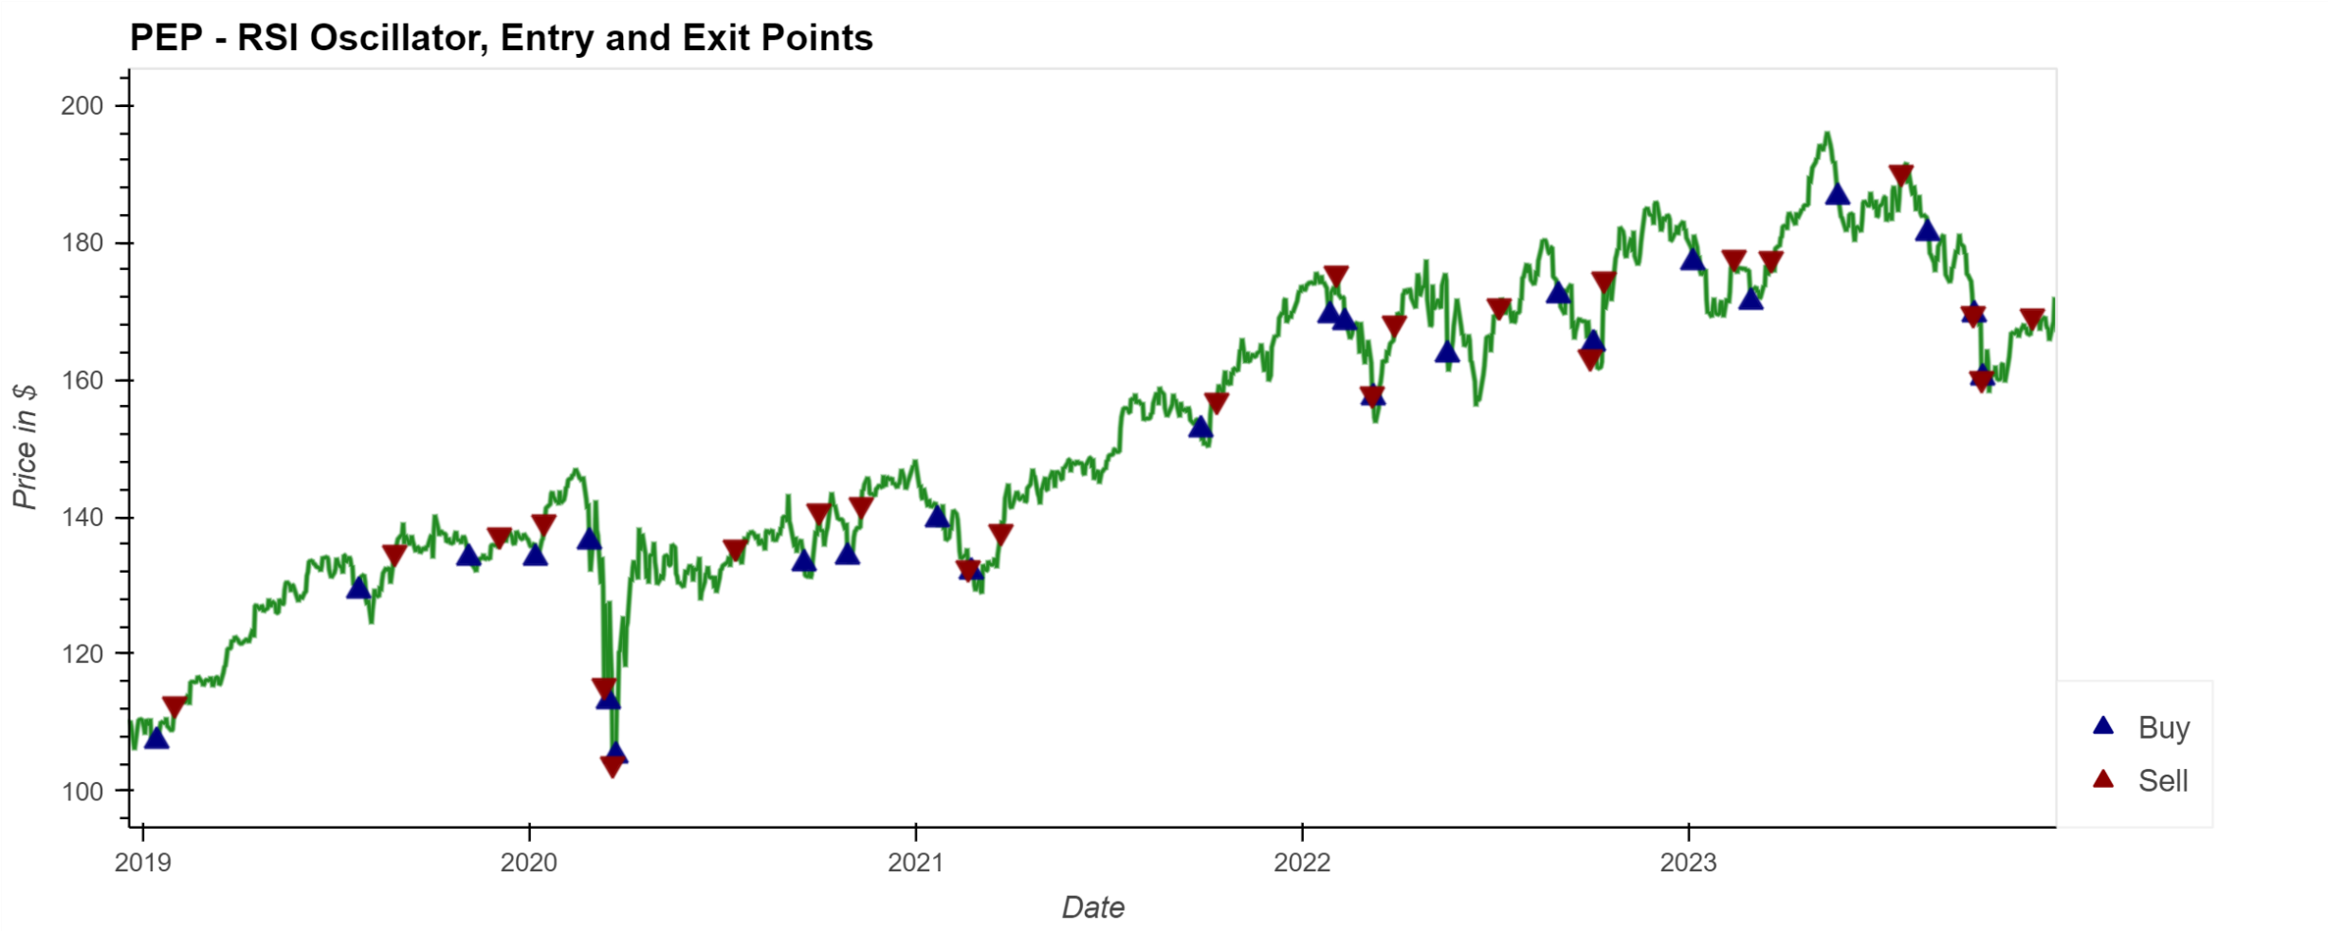
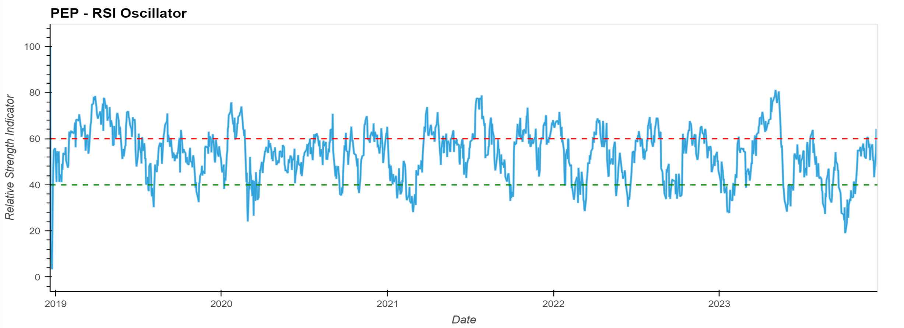
ALGORITHMIC STRATEGIES
Relative Strength Index (RSI)
RSI is a momentum oscillator measuring the speed and change of price movements, resulting in a number 0-100 estimated both overvalues and undervalues prices.
It uses recent gains and losses over a specified period (usually 14 days).
Determining Trading Signals:
Overbought Condition: RSI >= 70
Oversold Condition: RSI <= 30
Parameter Set up with Optimisation:
Overbought (Sell): 60 RSI
Oversold (Buy): 40 RSI
Period: 14 days
Stop Loss Percentage: 5%
Notes:
The narrower RSI range provided us with more trading signals, optimal based on back test analysis and worked better on top of other filters.

Slide 12
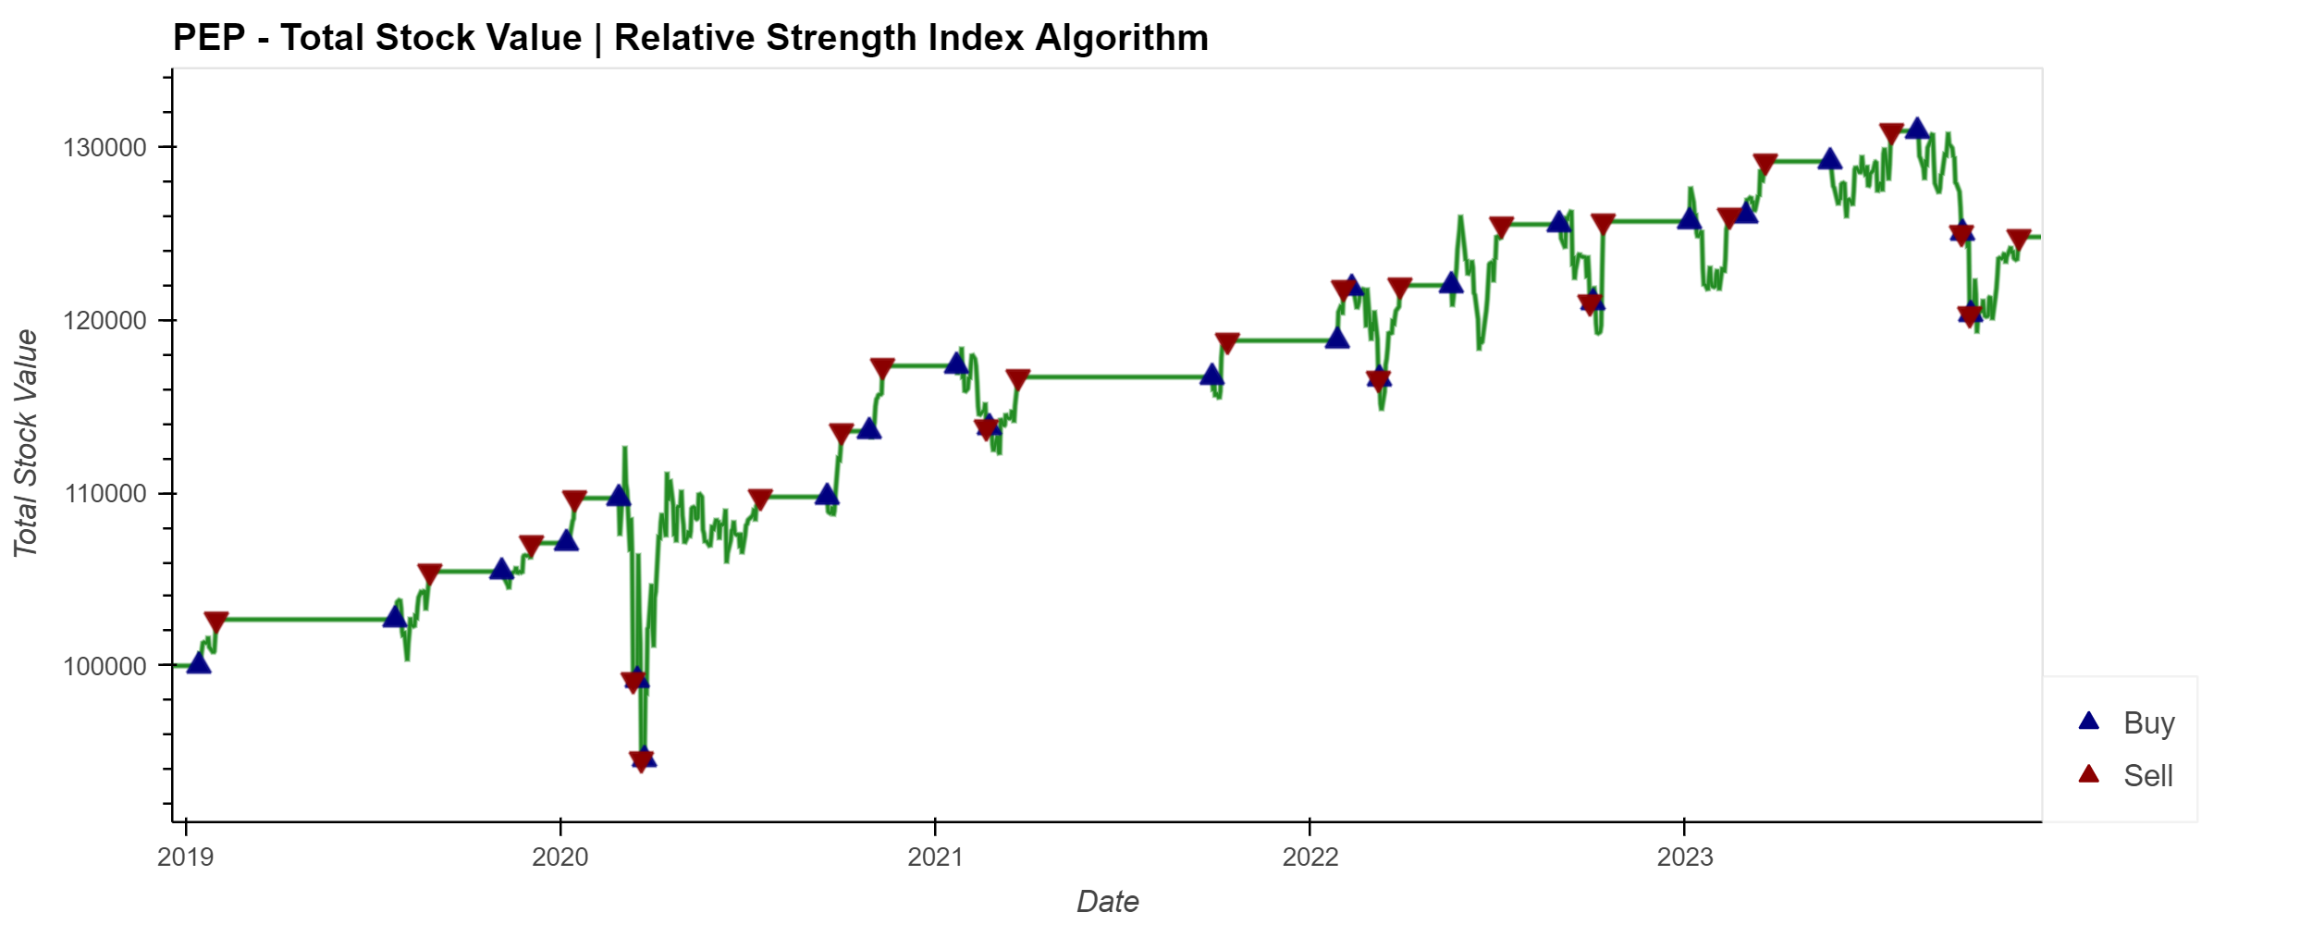
BACKTESTING AND ASSESSING
Assumptions
Initial Investment of $100,000.
Initial Share Size of 500.
Why Back testing?
Back testing is the evaluation of the potential success of a strategy through simulations across a set of trading rules.
Calculating the Portfolio Holdings, Cash, Total, Daily Returns, and Cumulative Returns for all three algorithmic strategies.
The Portfolio Total is now visualised against the entry/exit points to understand the actual market behaviour and compare how well the algorithm strategy performed.
Fortune Algo Cookies
Notes:
The narrower RSI range provided us with more trading signals, optimal based on back test analysis and worked better on top of other filters.

Slide 13
BACKTESTING AND ASSESSING
To further delineate the risk-reward characteristics of the trading algorithm the following metrics are evaluated.
Metric | DMAC Back test | Bollinger Bands Back Test | RSI Back Test
Annualised Returns | 0.52% | 7.5% | 4.9%
Cumulative Returns | 0.33% | 41.05% | 24.7%
Annualised Volatility | 9.4% | 11.1% | 10.4%
Sharpe Ratio | 0.054 | 0.67 | 0.47
Sortino Ratio | 0.053 | 0.67 | 0.47
Fortune Algo Cookies

Slide 14


OPTIMIZATION MODEL IMPLEMENTATION
THE MACHINE LEARNING MODELS USED IN OUR STRATEGY
Model | Advantages
Balanced Random Forest | Handles imbalanced datasets effectively. Reduces variance and avoids overfitting. Provides feature importance scores.
Support Vector Machines (SVM) | Effective in high-dimensional spaces. Works well with clear margin of separation. Versatile with different kernel functions.
Ada Boost | Combines multiple weak classifiers to improve accuracy. Automatically adjusts to the 'hardness' of data. Good at reducing bias and variance.
Fortune Algo Cookies

Slide 15

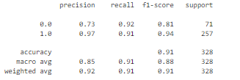
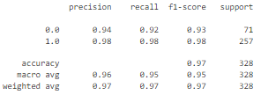
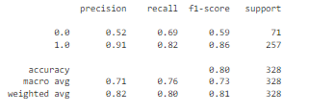
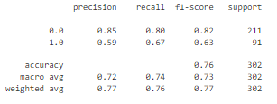
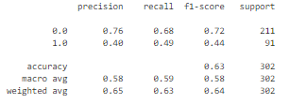
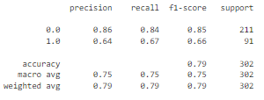
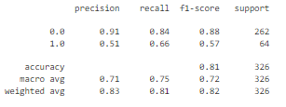
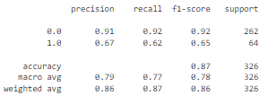
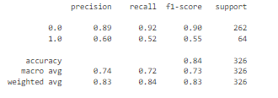
Fortune Algo Cookies
THE SELECTED MODELS &METHODOLOGY
Balanced Random Forest
SVM
AdaBoost
DMAC
BB
RSI

Slide 16
Conclusion
Conclusion based from the results and areas to improve and what can be done differently
Screenshot from backtesting module
Fortune Algo Cookies

Slide 17

POSTMORTEM
Difficulties
Additional problems
Potential Solution
Constraints of using freely accessible data limited the choices of data sources.
Integration issues
Many hours were spent trying to solve issues with the DMAC Backtesting module due to a number of internal library incompatibilities with Finta. Thankfully work-arounds were found.
https://github.com/peerchemist/finta/issues/102
A reasonable budget to allow access to premium historical data such as sentiment analysis, news, and other external factors could have provided a range of diverse and interesting perspectives to incorporate into our machine learning models.
Fortune Algo Cookies

Slide 18
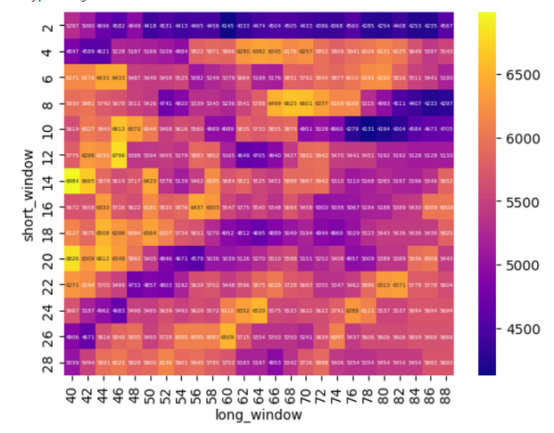
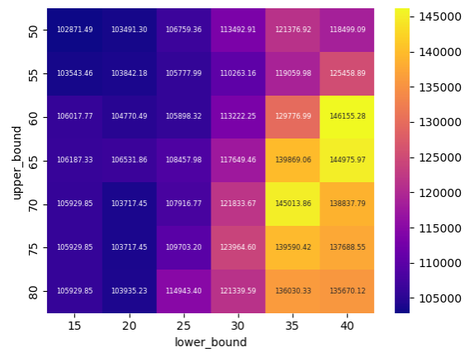
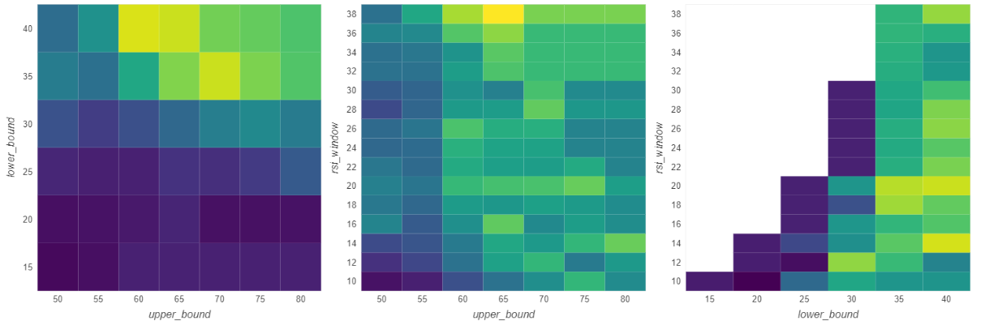
BACKTESTING
Back testing is a vital tool in the development of trading algorithms, which provides a risk-free way of evaluating the potential success of a strategy through simulations across a set of trading rules.
Simulations were run across a range of performance metrics on the DMAC and RSI algorithms, in order to fine tune the parameters (e.g., window sizes, upper / lower bands) for those trading algorithms.
Optimize function was especially useful to run ranges of simulations with multiple parameters from which heat maps were plotted showing the optimal results (see figures), being how we derived our final settings.
Back-tested various combinations of the ML parameters manually by inspecting the status reports.
DMAC Backtest Heatmap
Windows x=long, y=short
RSI Backtest Heatmap
Bands x=lower, y=upper
Additional RSI Backtest Heatmaps
Left:
x=lower band
y=RSI window,
Right:
x=upper band
y=RSI window,
Fortune Algo Cookies
* github.com/kernc/backtesting.py

Slide 19

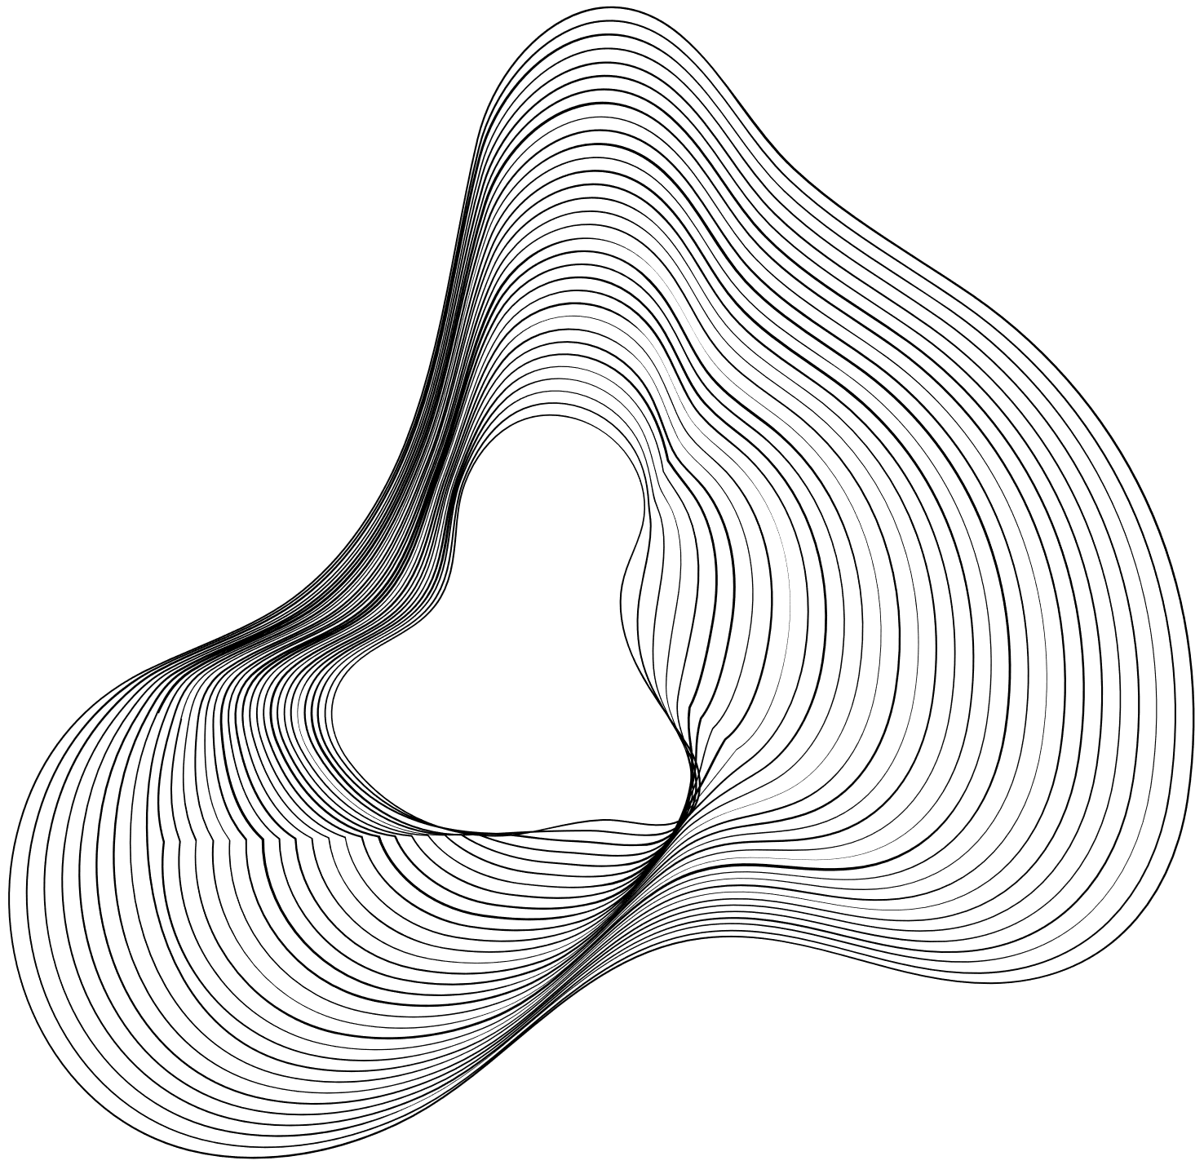
Future plans
What else could we have done if we had more time:
Refine trading signal rules (e.g. capital management)
More historical data - e.g. interest rate, inflation, exchange rate
Integrate Sentiment Analysis - draw historical sentiment data
Create models catering for more riskier / volatile stocks
Create models for different trading styles (e.g. intra-day)
Implement Backtesting on the Bollinger Band model to find the optimal window size and STD values
Fortune Algo Cookies

Slide 20
PATH TO INTEGRATION
ASSESSED THE BRIEFING AND AS A TEAM AGREED ON THE PROJECT SCOPE AND OBJECTIVES
NON-EXHAUSTIVE SEARCH FOR AVAILABLE DATA SOURCES
PROOF OF CONCEPT USING SHORT LIST OF DATA SOURCES AND MODULES
CODING AND TESTING
ANALYSIS AND REMODELLING
START
FINALISE GITHUB REPOSITORY
PRACTICE RUN
PRESENTATION PREPARATION
DOCUMENT FINDINGS
END
Fortune Algo Cookies

Slide 21



Q&A Session

Slide 22



Thank you!
Together, we can bridge the gap in technology to access extraordinary opportunities.
Merry Christmas
& A Happy New Year!
Fortune Algo Cookies

Slide 23
Appendix - Glossary
Concept | Short Explanation
Time Series Analysis with Prophet | Prophet is a forecasting tool designed for analyzing time series data which might have irregular trends. It's especially useful for datasets with strong seasonal effects and several seasons of historical data.
DMAC (Dual Moving Average Crossover) | DMAC is a trading strategy that uses two moving averages of different lengths. A trading signal is generated when the short-term average crosses the long-term average, indicating a potential trend change.
Bollinger Bands (BB) | Bollinger Bands are a technical analysis tool that consists of a moving average and two standard deviation lines. These bands widen during high volatility and narrow during low volatility, helping identify overbought or oversold conditions.
RSI (Relative Strength Index) | RSI is a momentum indicator that measures the speed and change of price movements to identify overbought or oversold conditions. Values above 70 indicate overbought, and below 30 indicate oversold.
Backtesting | Backtesting involves testing a trading strategy using historical data. It helps evaluate the strategy's effectiveness and its potential for success under different market conditions.
Balanced Random Forest | This is a variant of the Random Forest algorithm that is specifically tuned to handle imbalanced datasets. It combines the simplicity of decision trees with ensemble learning to improve prediction accuracy.
Support Vector Machines (SVM) | SVM is a supervised machine learning model that classifies data by finding the best hyperplane that separates different classes in the feature space. It's effective in high-dimensional spaces.
Ada Boost | Ada Boost, short for Adaptive Boosting, is an ensemble learning method that combines multiple weak classifiers to form a strong classifier. It adjusts the weights of misclassified instances to improve model accuracy.

Slide 24
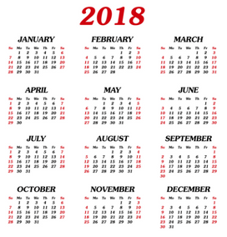



Train
Test

